Slide 1
Robotic Hand
by High Five Team

Slide 2
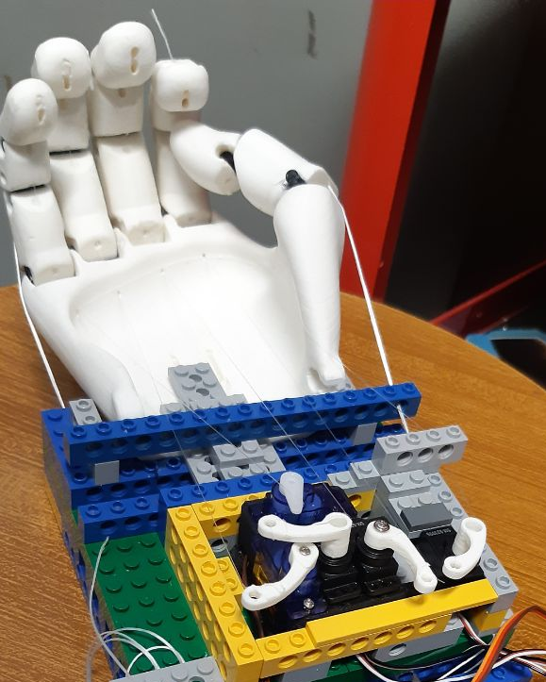
Our project
Our idea is to help people who have lost their hand due to accidents. After a long brainstorming we came to the conclusion of creating a robotic hand controllable with thought.

Slide 3
Steps of the project
The first step is to print a 3D robotic hand model and control it by Arduino.
After printing the hand we move on to the second phase, where we reproduce the movements of the real hand on the robotic hand using the Leap sensor.
Finally, we focused on the last phase and connected our robotic hand with the Emotiv sensor

Slide 4
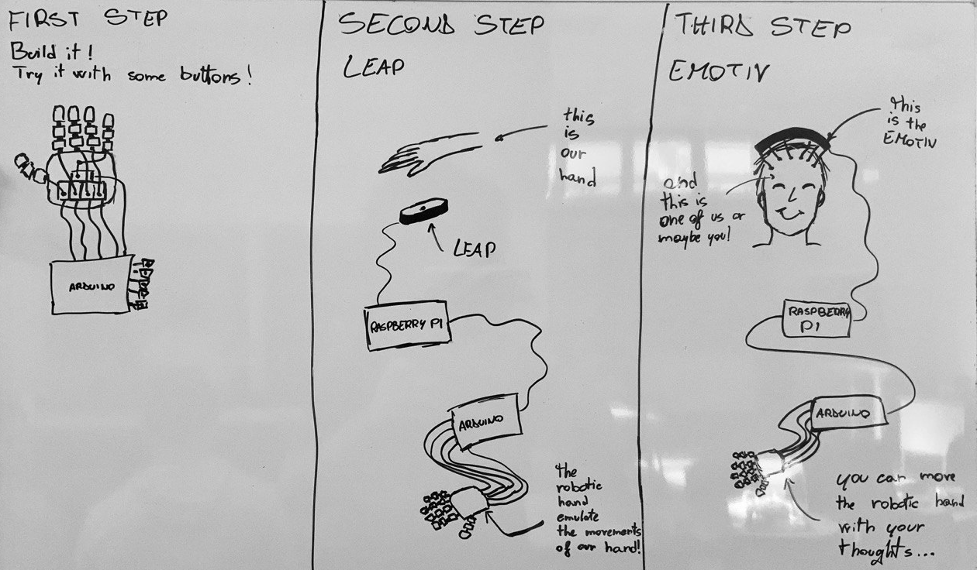
Steps of the project

Slide 5

The materials
The Leap Motion Controller is an optical hand tracking module that captures the movements of your hands with unparalleled accuracy.
Leap sensor is used for take information about the human's hand and for control the robotic hand.

Slide 6
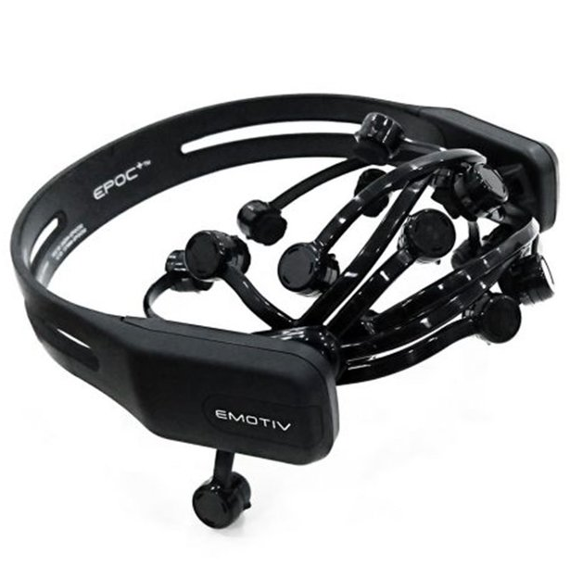
Emotiv
The EMOTIV EPOC+ is designed for scalable and contextual human brain research and provides access to professional grade brain data with a quick and easy to use design.
Emotiv is used for control the robotic hand with thought.

Slide 7
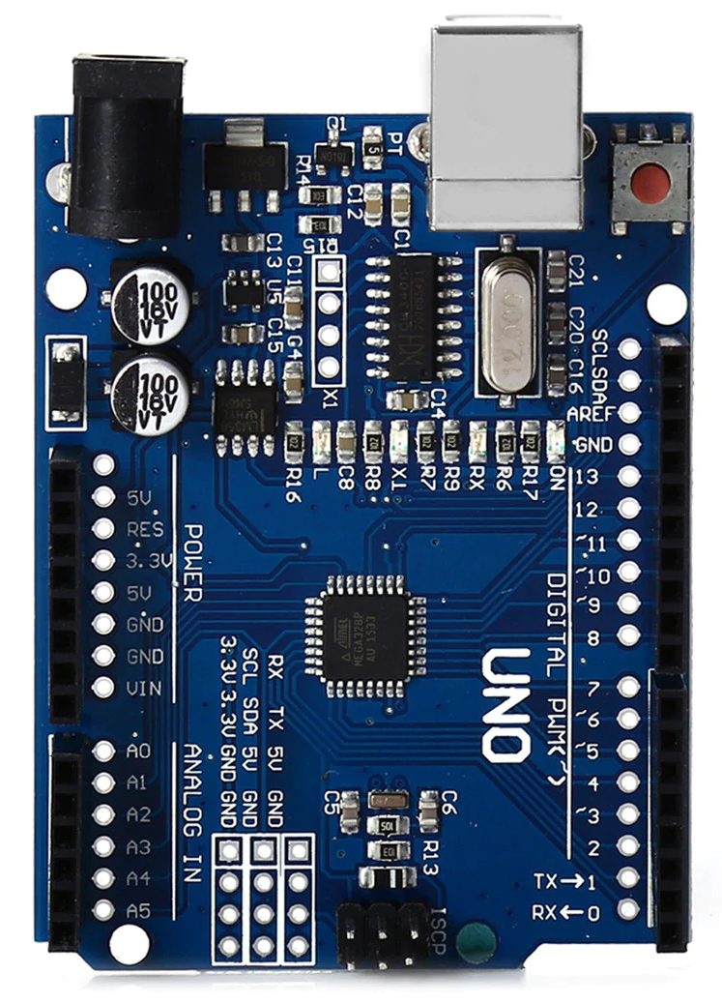
Arduino UNO
Arduino is an open-source electronics platform based on easy-to-use hardware and software. Arduino boards are able to read inputs - light on a sensor, a finger on a button, or a Twitter message - and turn it into an output - activating a motor, turning on an LED, publishing something online. You can tell your board what to do by sending a set of instructions to the microcontroller on the board.
Arduino is used to power the motors and based on the sensor data received, Arduino resets the various motors.

Slide 8
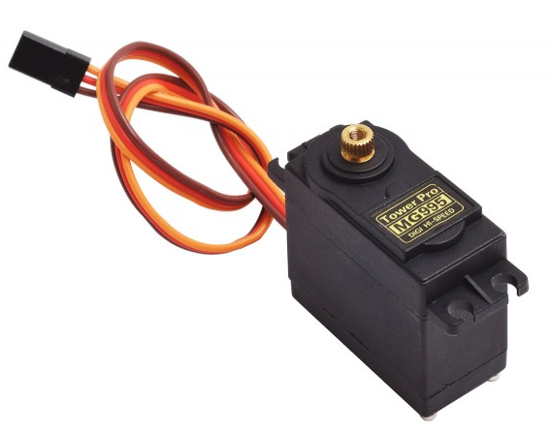
Servo Motor
A servomotor is a rotary actuator or linear actuator that allows for precise control of angular or linear position, speed and acceleration. It consists of a suitable motor coupled to a sensor for position feedback.
We used these servomotor for moving fingers.

Slide 9
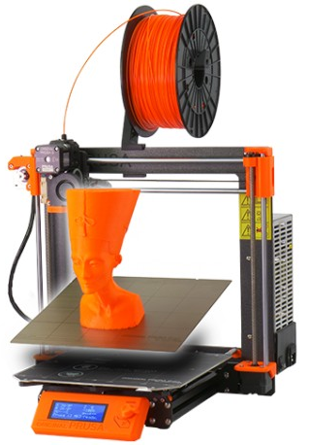
3D printer
We used the 3D printer for creating our hand.

Slide 10
History of the project
04
The idea
Final 3D Printed model
What can we do? Maybe a robotic hand is a good challenge for us.
We changed the design of the hand and printed the final hand.
01
03
First Lego prototype
3D Printed failed model
We needed a prototype for testing the first version of program, so we thought at LEGO
the first 3D printed hand was a failure, we had used an unsuitable plastic
02

Slide 11
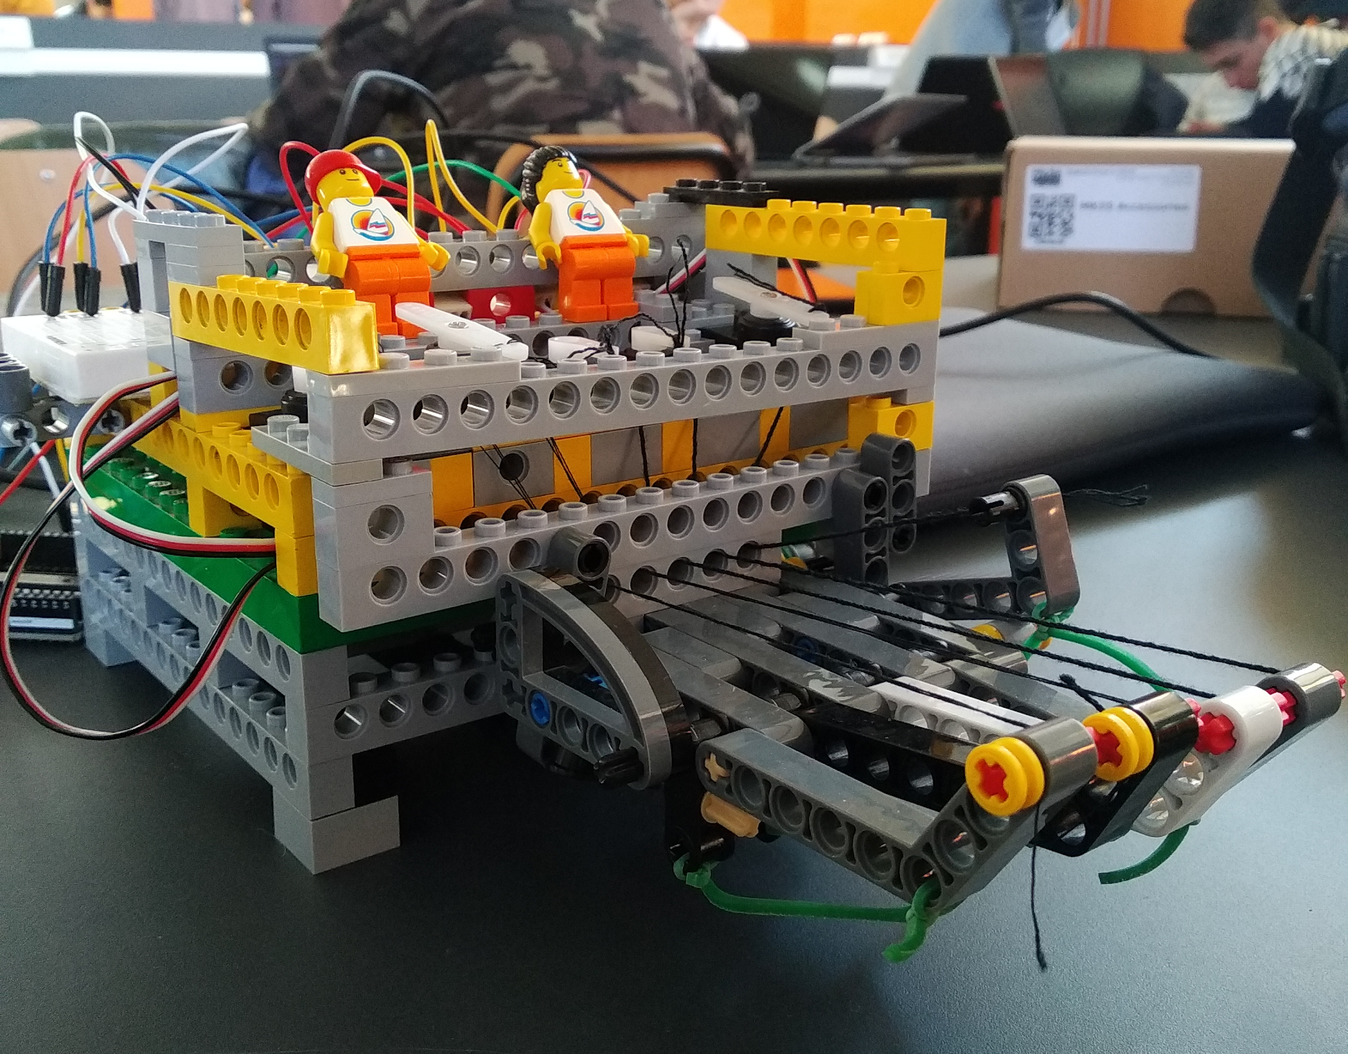
First Lego prototype
History of the project
We needed a reliable model to start testing the first versions of code while we were waiting for 3d printed one, so we thought we'd build it in LEGO technic bricks.

Slide 12
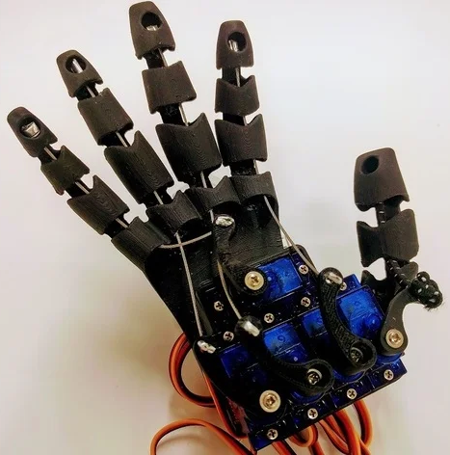
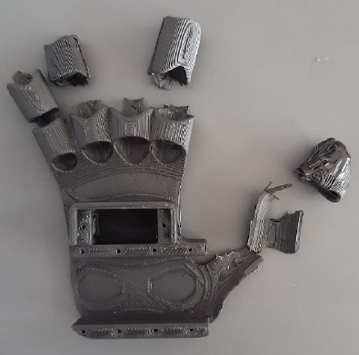
3D Printed failed model
History of the project
After some research we found an optimal prototype for our project, we printed it but the quality was not high and the material was not flexible enough.

Slide 13
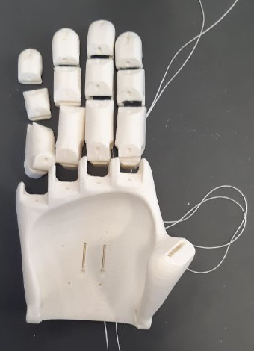
Final 3D Printed model
History of the project
Then we found another hand. Being the hand assemblable, we decide to try to print it in 3D only the thumb, with the appropriate joints and avoid wasting other material.

Slide 14
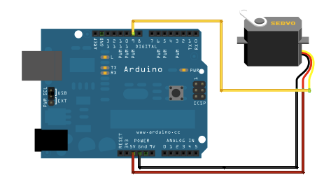
The programs
We started with programming the Arduino to test the servomotors.

Slide 15
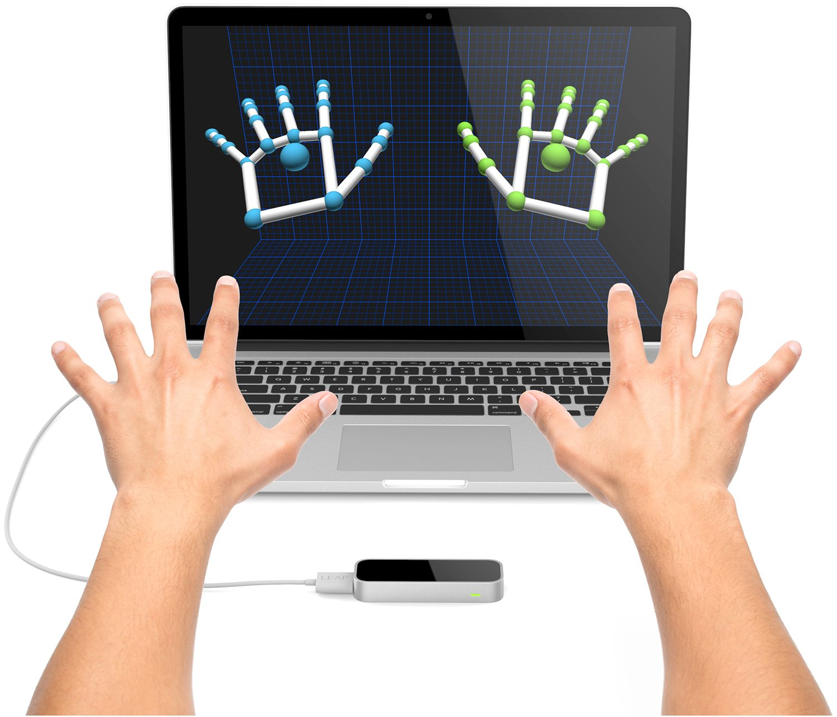
The programs
Then we developed a program to read data from the Leap, an infrared device that reads the positions of the several parts of the hand. At this point we encountered a problem: how to understand when the hand is open and when it is closed. We solved the problem by deciding to calculate the distance between the fingertip and the center of the hand. Shorter the distance is, closed the fingers are.

Slide 16
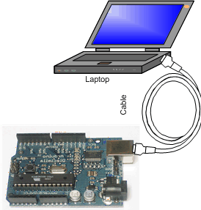
The programs
Now we have to transmit this calculated data to Arduino: so we developed a communication protocol in python.

Slide 17
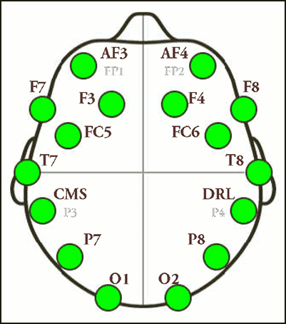
The programs
Finally, we used the EPOC + programs and our protocol to allow control from the hand with the Emotiv, a helmet that recognizes the impulses that our neurons exchange.

Slide 18
The programs
You can visit our repo in github for downloading the code of our programs.
https://github.com/Bagnis-Gabriele/Robotic-hand

Slide 19
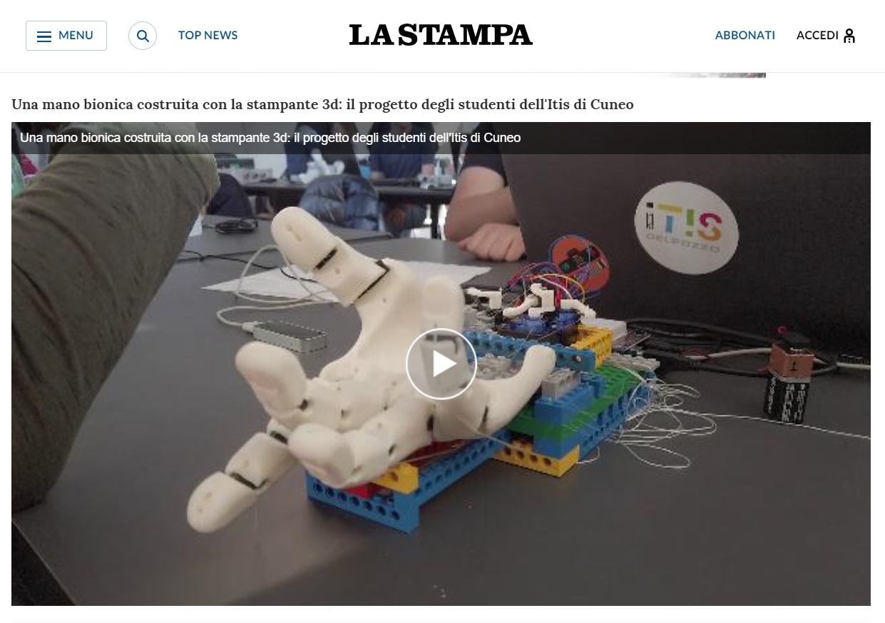
Our project was as successful that we also gave a press interview: https://video.lastampa.it/cuneo/una-mano-bionica-costruita-con-la-stampante-3d-il-progetto-degli-studenti-dell-itis-di-cuneo/108755/108765
Our success

Slide 20
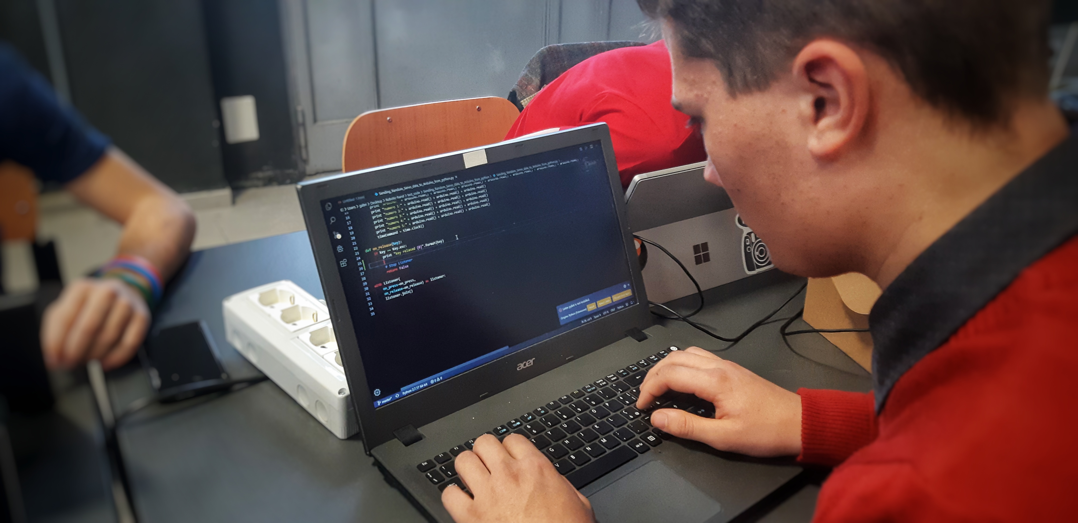
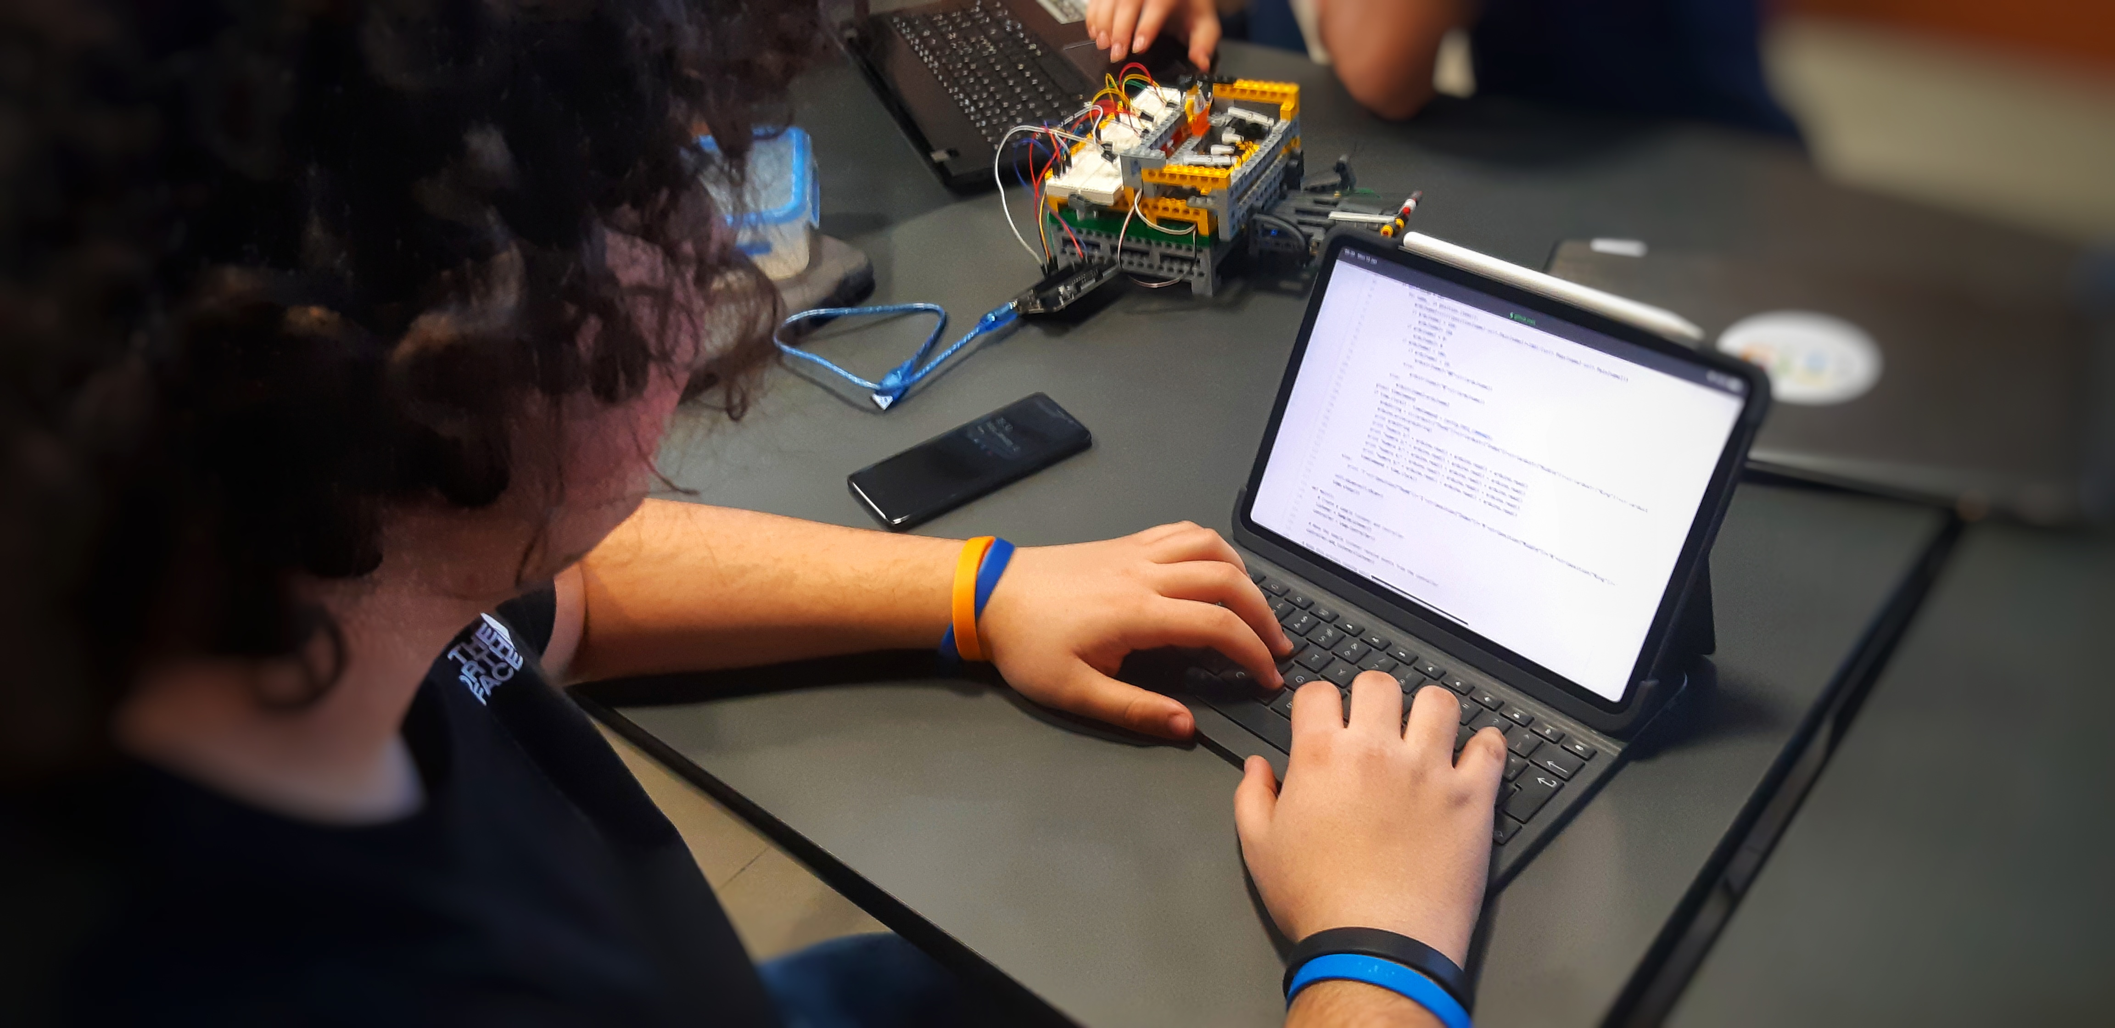
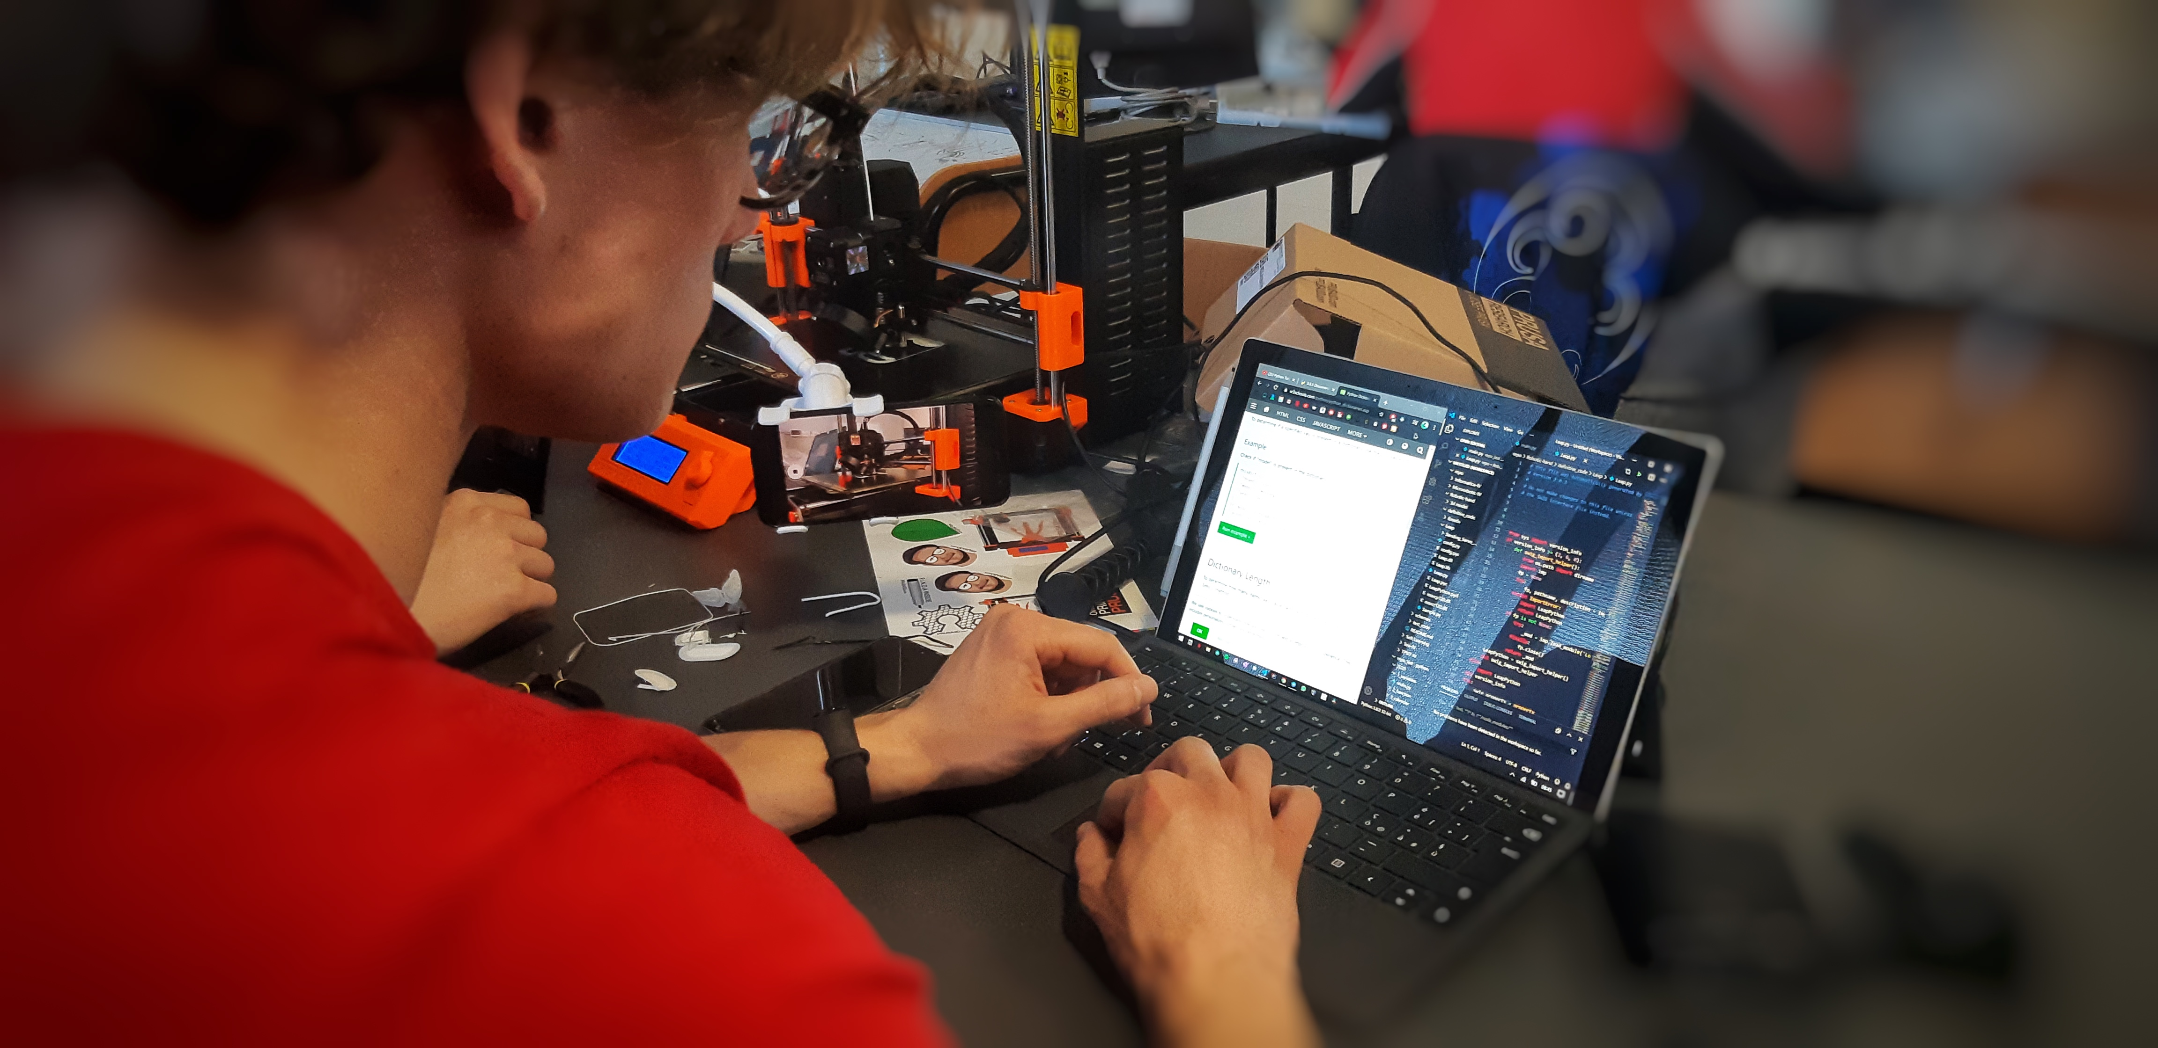
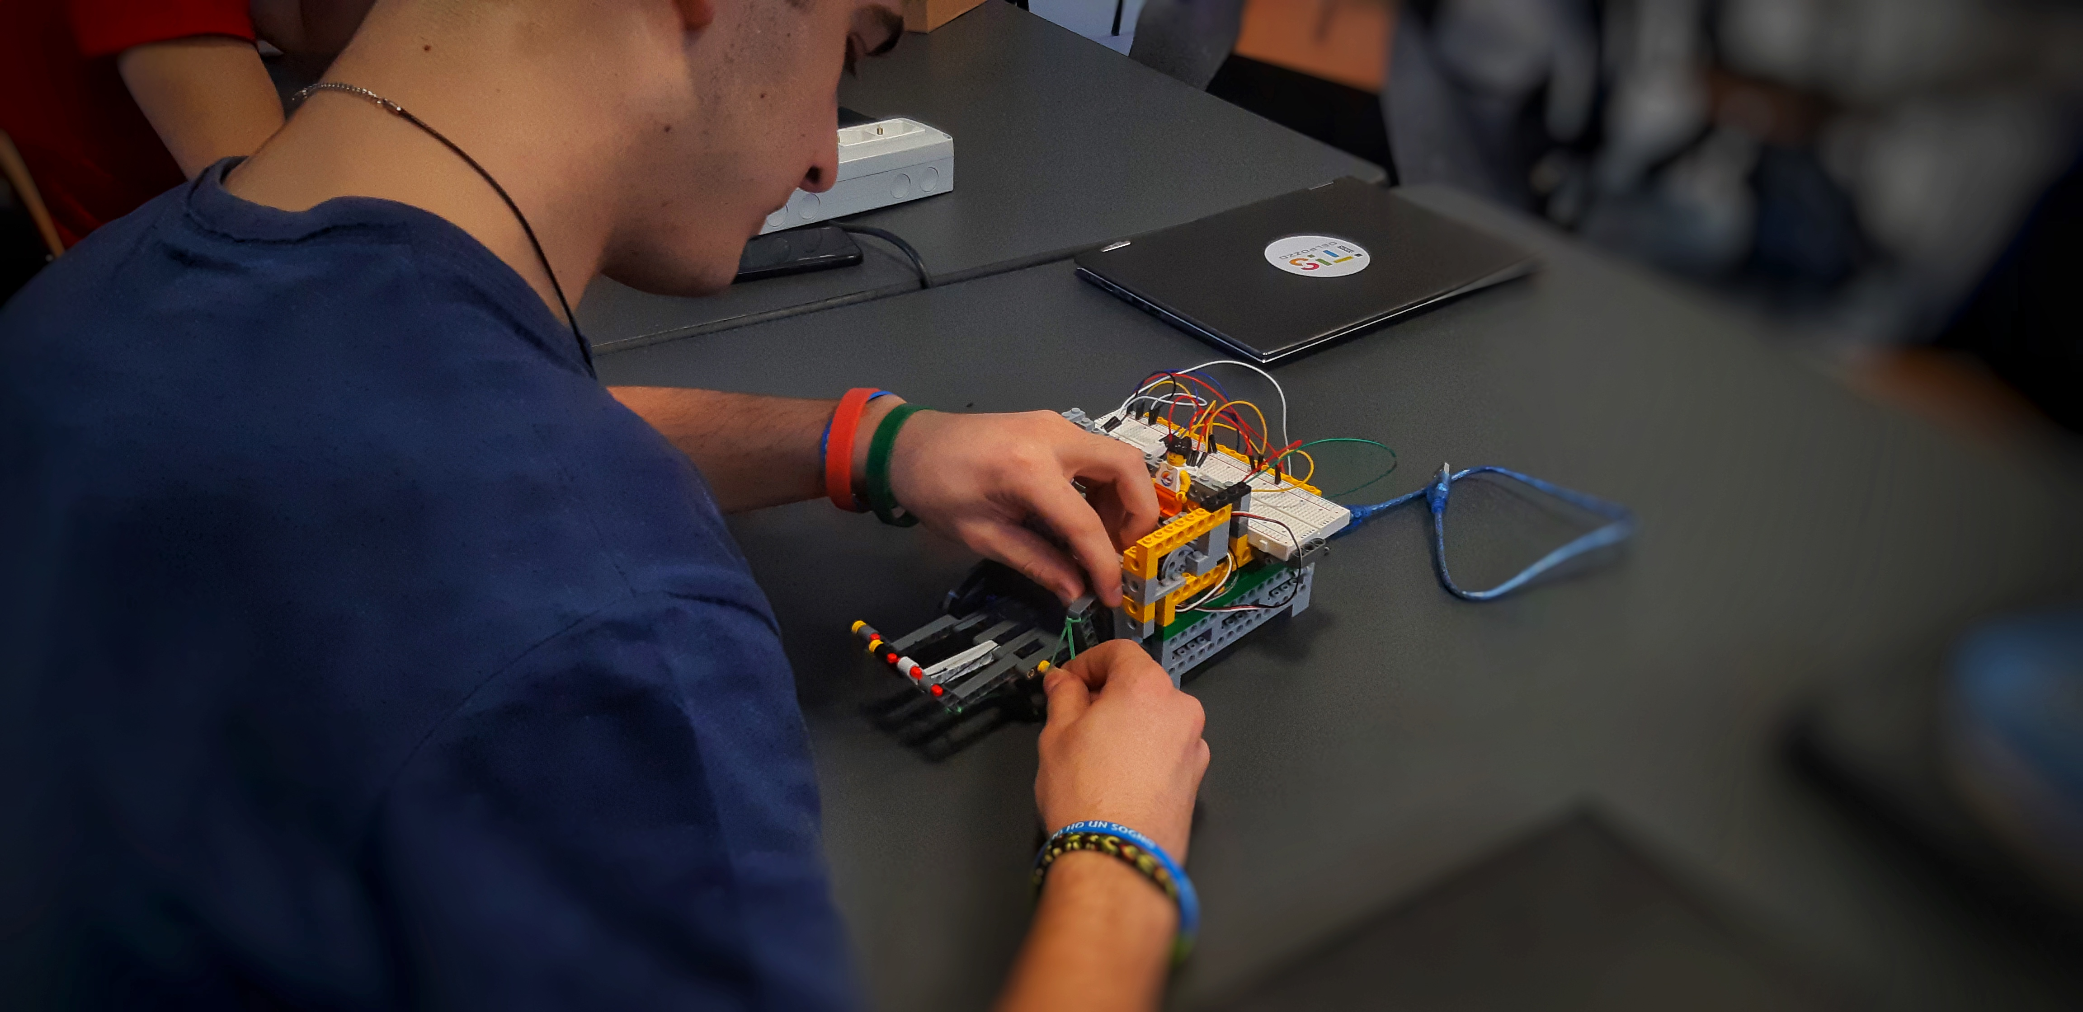
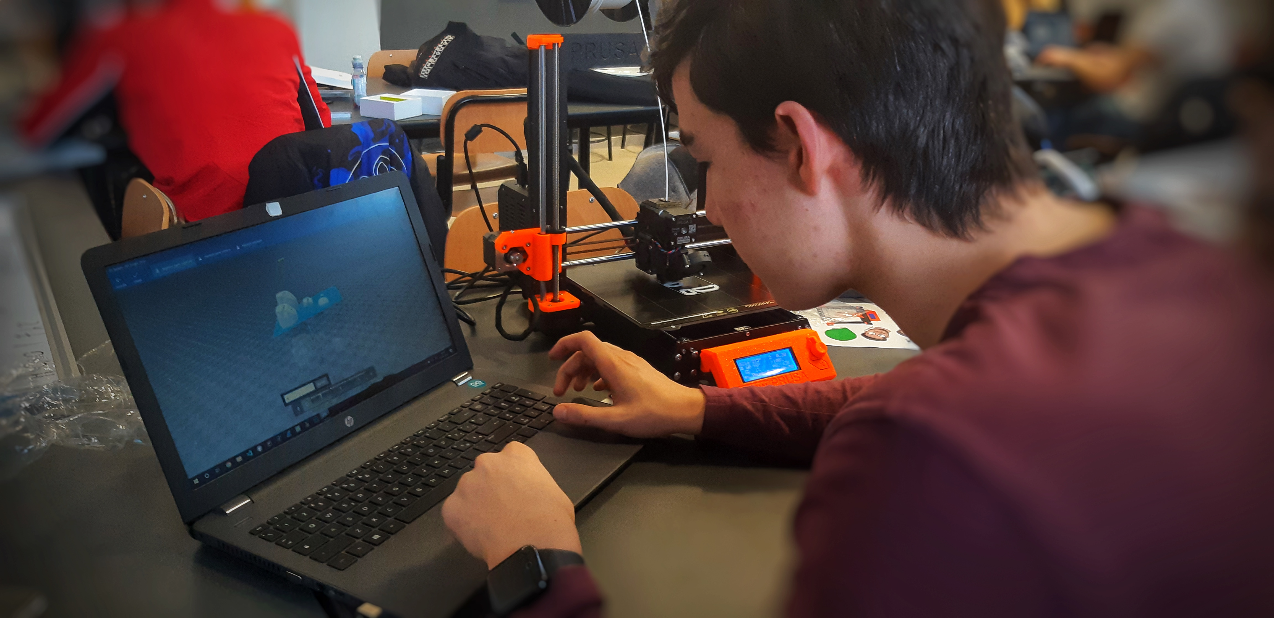
Our team is made up of Bagnis Gabriele & Giavelli Luca, the programmers and Bruno Luca & Cuniberti Andrea & Genovese Tommaso the technicians.
Our team

